Slide 1

Team TPH
Technology Professionals of Hanoi

Slide 2

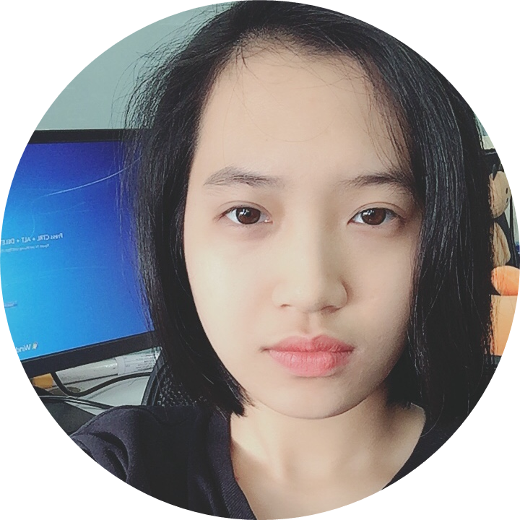
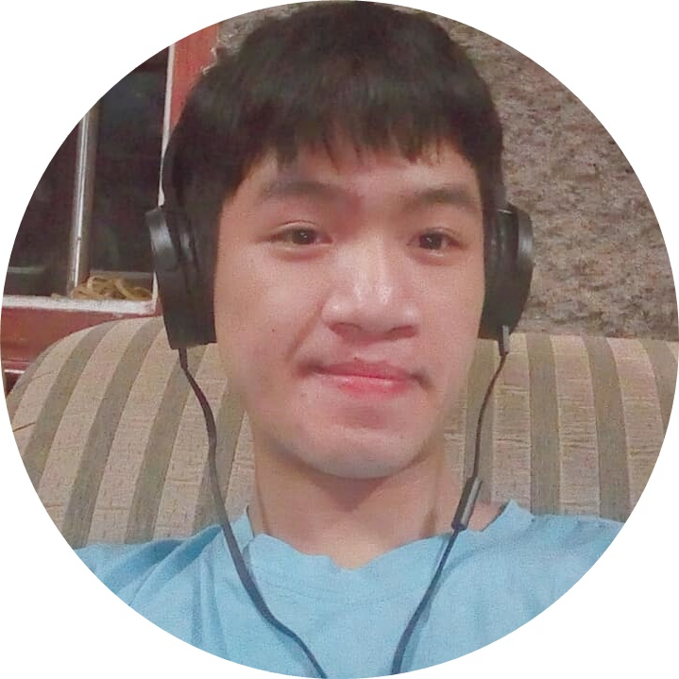
Members
Trang
Developer
Phượng
Business Analyst
Hồng
Developer

Slide 3
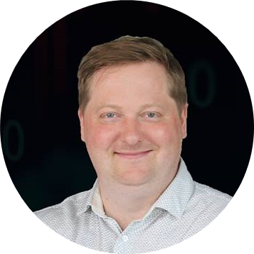
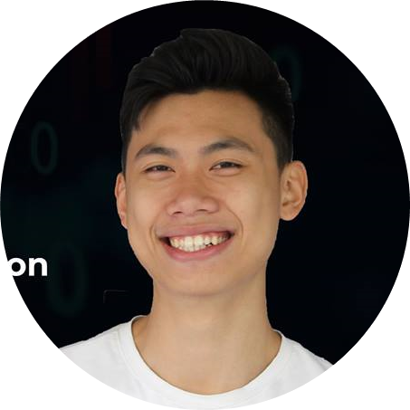
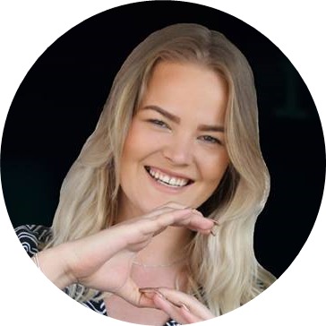
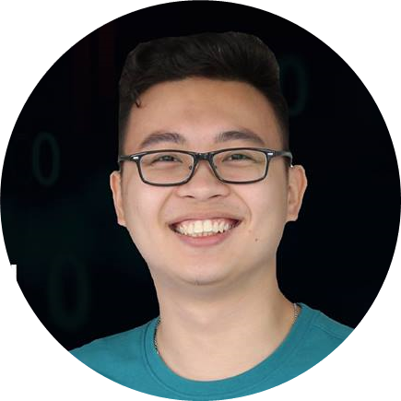
Cost Split Solution
Mr Antti
Mr Tall-Hai
Ms Saara
Mr Hai
150$
40$
70$
0$
Total: 260$
Average: 65$

Slide 4
Still need to pay
Mr Antti
Mr Tall-Hai
Ms Saara
Mr Hai
- 85$
25$
- 5$
65$
=
=
=
=
65$ - 150$
65$ - 40$
65$ - 70$
65$ - 0$

Slide 5
Transactions
65$
5$
25$
85$

Slide 6
App Demo

Slide 7
Co-saving
$
$
User 3
Goal
User 4
$
$
User 1
User 2
A group of people, have the same goal, and save the money together to achieve that goal

Slide 8
Chơi Hụi
We want to give you something more
It used to be very popular with Vietnamese women in the old time,
when the concept of Commercial Bank is still not existed in Vietnamese people’s mind.

Slide 9

Fun Saving
Let’s call it

Slide 10
The Rules
Mr Antti
Mr Tall-Hai
Mr Hai
Ms Saara
Game Owner
1. The number of player is limitless
2. One person is chosen to be the game owner. This person’s responsibility is to collect money from participants.

Slide 11
The Rules
4 Weeks
4 Weeks
4 Weeks
4 Weeks
Start
End
Round 1
Round 2
Round 3
Round 4
3. Number of player = Number of round
4. You choose the duration of each round

Slide 12
Round 1
200$/p
200$/p
200$/p
200$/p
Start
End
1st week
2nd week
3rd week
4th week
5. Each week, everyone has to give the game owner a set amount of money.

Slide 13
The most fun part
200$ x 4 people x 4 weeks
=
3200$
6. At the end of each round, a random player will receive
everyone’s saved money of that round from the game owner

Slide 14
The game end
4 Weeks
4 Weeks
4 Weeks
4 Weeks
Start
Round 1
Round 2
Round 3
Round 4
3200$
3200$
3200$
3200$
7. Each person can only receive the money once
8. The game ends when everyone has received the money.

Slide 15
App Demo

Slide 16
Thank you for listening!

